Slide 1
On RTG Design
Alexander Hoppe and Taylor Sheneman

Slide 2
Our System

Slide 3
Our System
Really expensive stuff
Also really dangerous.

Slide 4
How little plutonium can we use for a given power and mission length?

Slide 5
Our Key Assumptions
The RTG can be modeled as a cylinder of plutonium
The only way energy enters the system is by radioactive decay
The only ways energy leaves the system are by radiation or as electrical power
Electrical power is 6% of the radiation flow
The temperature of space is a constant 2 Kelvin

Slide 6
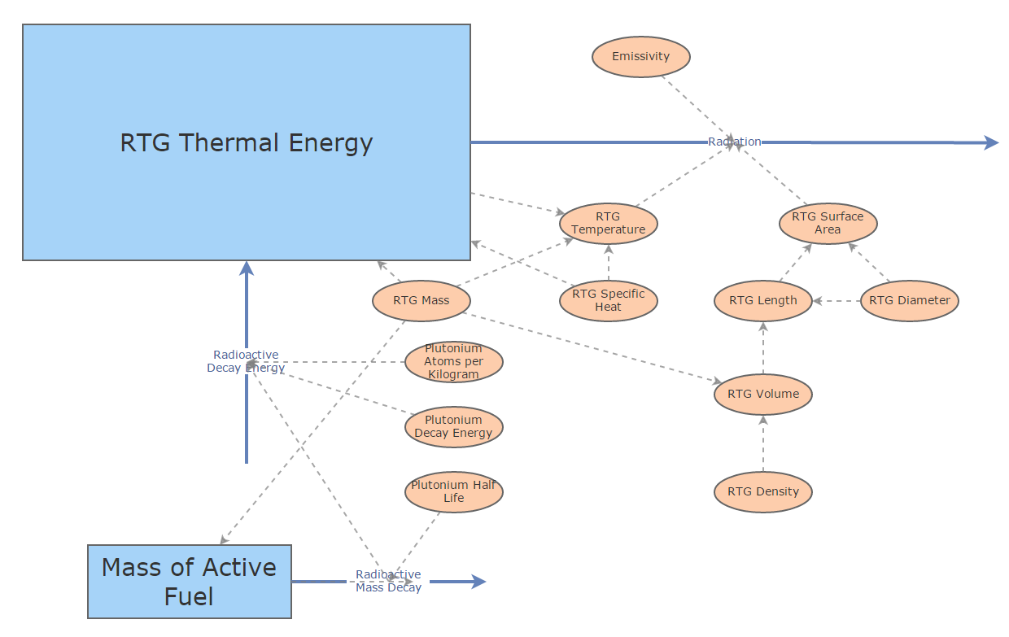
Our Model

Slide 7
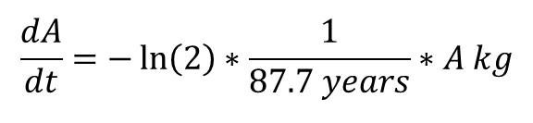
Our Differential Equations
$$\frac{dA}{dt}=−\ln\left(2\right)∗\frac{1}{87.7 years}∗A kg$$
$$\frac{dQ}{dt}=\frac{dA}{dt}kg years^{−1}∗\left(2.53∗{10}^{24}\right)atoms kg^{−1}∗\left(8.96∗{10}^{−13}\right)Joules atom^{−1}$$
$$− 0.9∗5.670 W m^{−2}K^{−4}∗(3.1569∗{10}^{7})s year^{−1}∗T_{RTG}^{4}$$

Slide 8
Our Simulation
Power Threshold = 100W

Slide 9
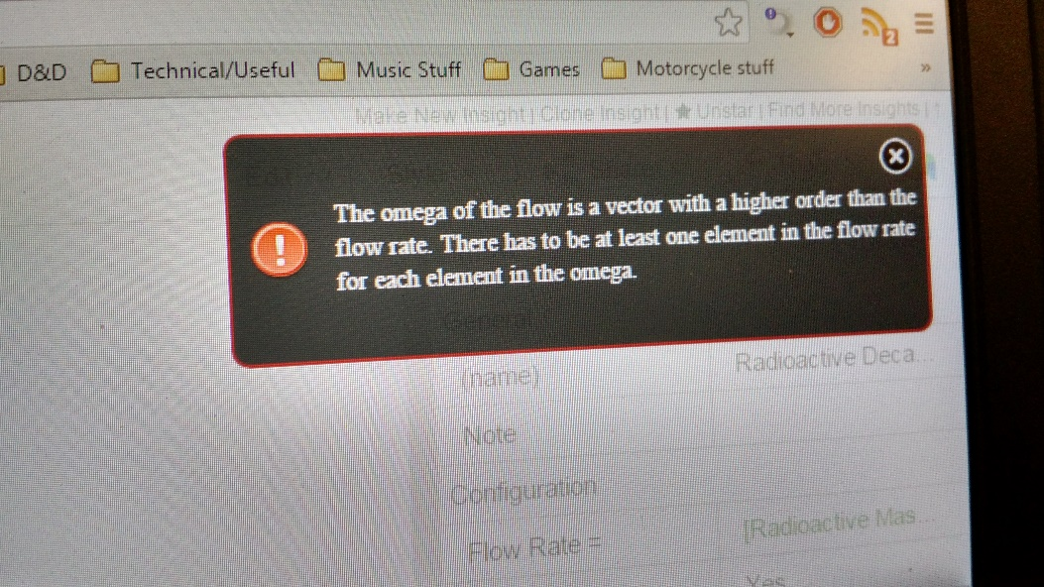
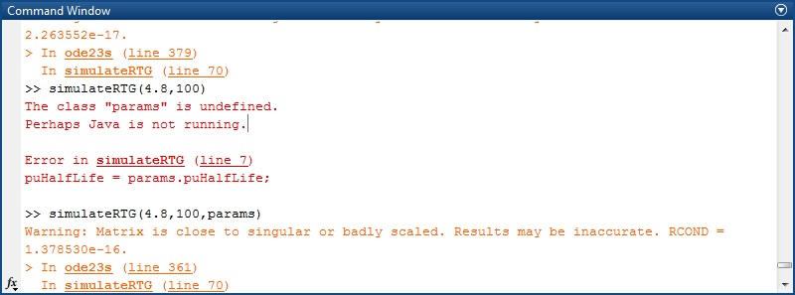
Our Failures
Anomaly
Matlab:
Insight Maker: “Are you dividing by zero?”

Slide 10
Our Takeaways
Insight Maker isn’t worth the effort
Some ODE solvers work better for some things than others
Pair programming and fresh eyes work wonders
Close enough is good enough

Slide 11
Our Design Recommendation
Length of New Horizons Mission: 10 years
Mandated Power Threshold: 200W
Required ²³⁸ Pu payload: 7 kg
New Horizons ²³⁸ Pu Payload: 8.6 kg
At $8 million per kg of ²³⁸ Pu,
We could have saved NASA 12.8 million dollars
Voyager 1 (so far)
Alpha Centauri B Orbit (theoretical)
New Horizons (modeled)

